Slide 1
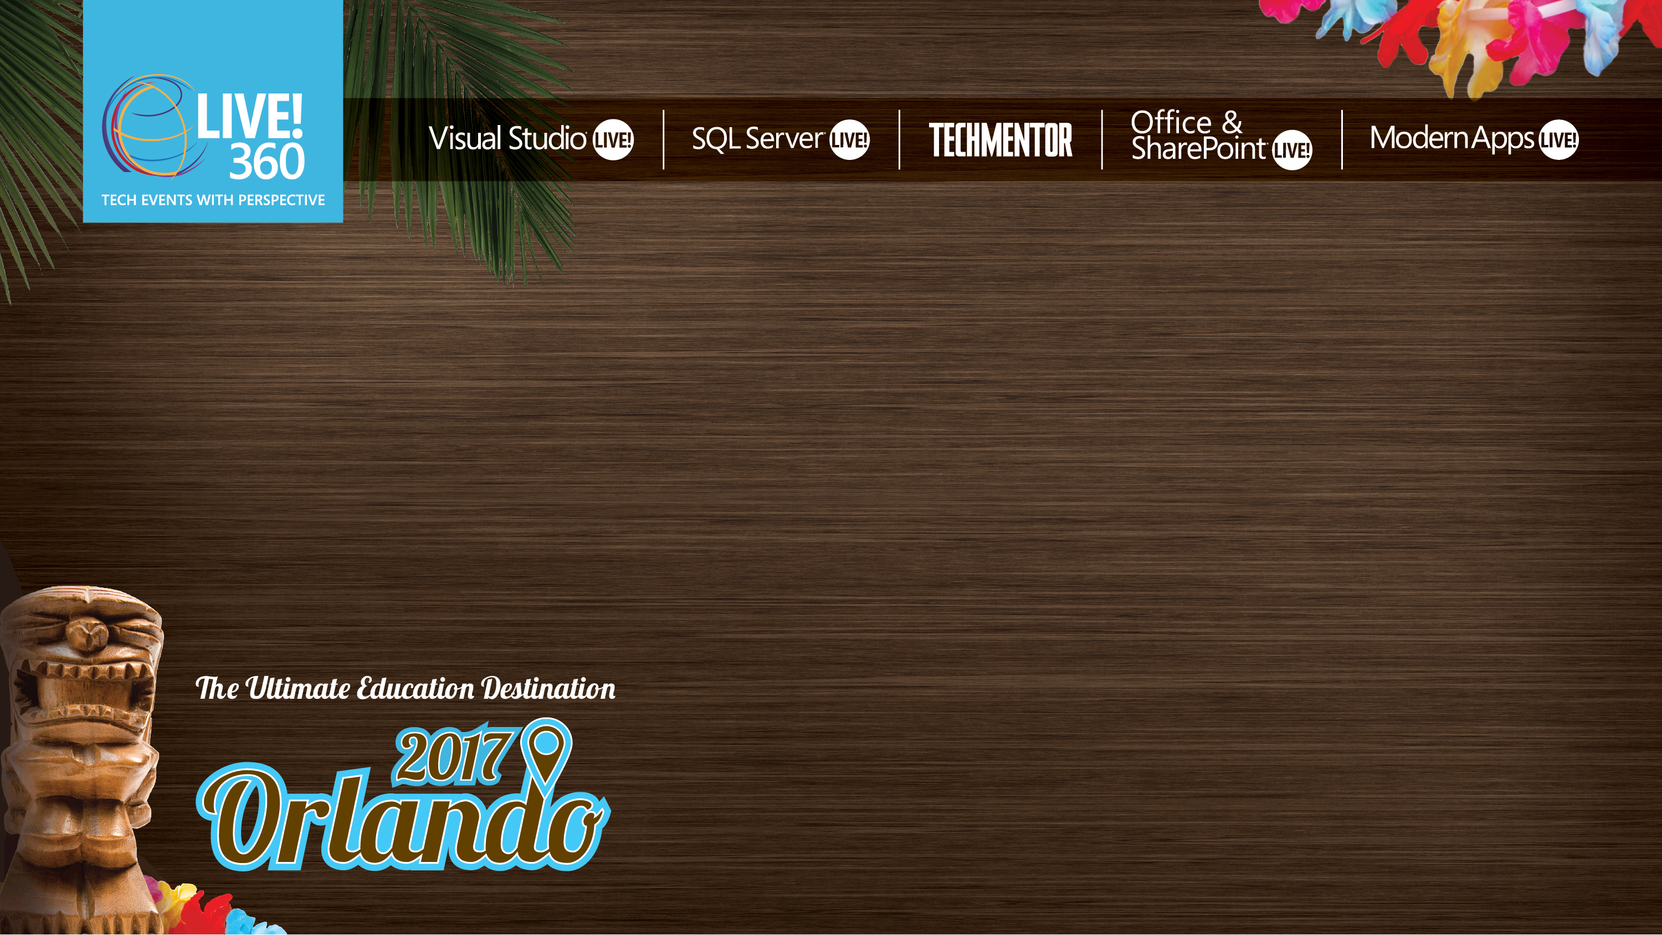
TMH02 Keep Up with NOW! Automate Rebuilding Your (Home) Lab On Steroids
Sven van Rijen
Senior Desktop Engineer @ Wageningen University & Research (WUR)
Level: Intermediate

Slide 2
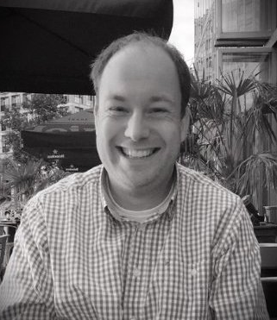
About me!
Sven van Rijen
35 years old (36 almost)
Full time in IT since 2002
I live in Wageningen, The Netherlands!

Slide 3
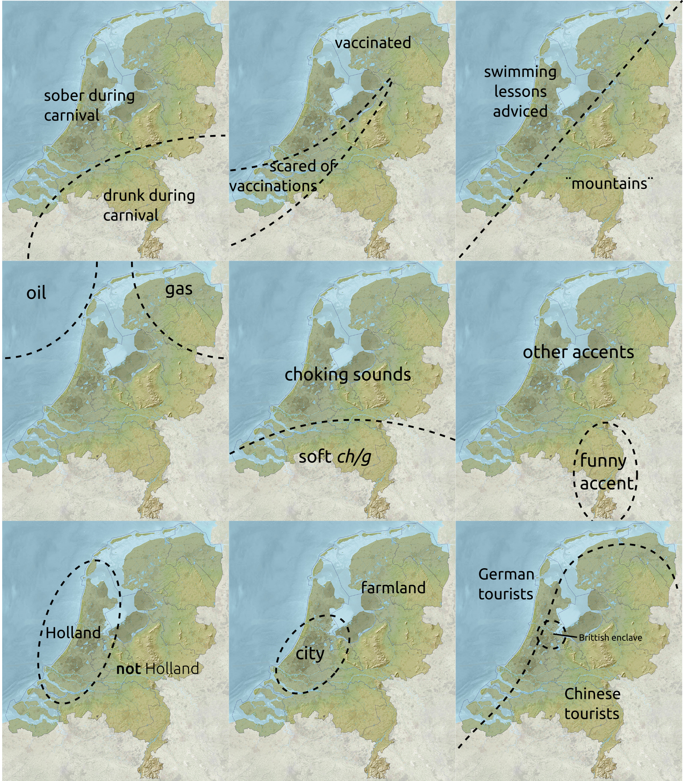
Why Holland Is Not the Netherlands – and some Other Dutch Dichotomies
http://bigthink.com/strange-maps/why-holland-is-not-the-netherlands-nil-and-eight-other-dutch-dichotomies

Slide 4
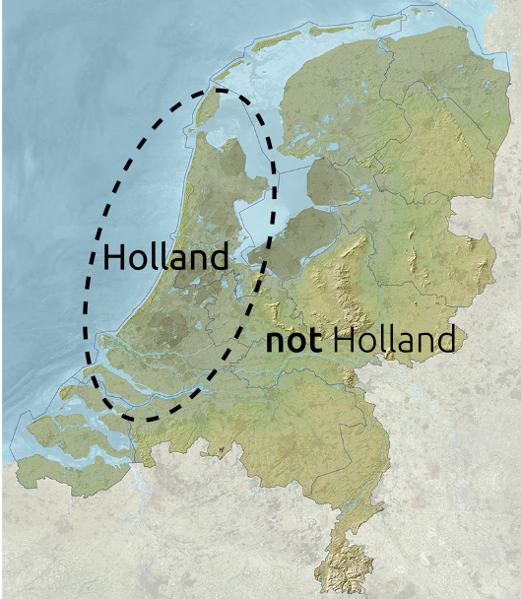
Notes:
Holland is the most populated and culturally dominant part of the Netherlands, hence the conflation of one with the other. But in fact, the geographical area comprised by Holland is relatively small, and only covers two of the Netherlands’ 12 provinces: North Holland and South Holland. Incidentally, there is no link between Nether- and Hol-, as the second prefix derives not from hollow or anything like it, but from holt (‘wood’), as in ‘wooded country’ (Holt-land). Netherlanders outside Holland have been known to get miffed, upset or even angry if one refers to them as Hollanders. Nevertheless, Holland is used informally as a synonym for the whole country in the Netherlands itself, and has even achieved formal status abroad – the official term for the Netherlands in Filipino is Olanda, in Japanese Oranda, in Polish Holandia, etcetera.

Slide 5
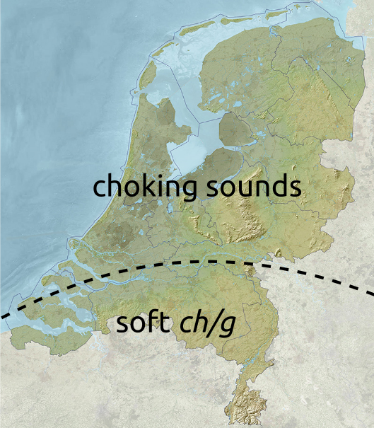
Notes:
The Dutch language gets a bad press for being an especially guttural language – all spit and gurgles, but that is true only in the northern part of the country. The south pronounces its g-sounds much softer, a bit like the Dutch-speaking Belgians do.
I’m from the South myself, born and raised aprox. 12km from the Belgian border.

Slide 6
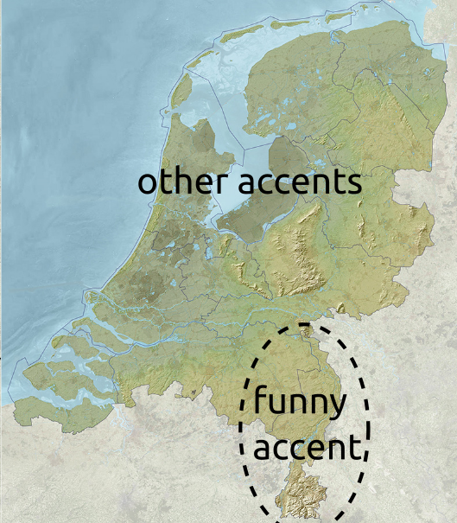
Notes:
The Netherlands has one of the weirdest territorial appendages in Europe – its southern province of Limburg, at its narrowest a corridor less than three miles wide between Germany and the Belgian province of Limburg (4). Geographical eccentricity is compounded by linguistic divergence: the Limburg dialect is a close cousin to dialects spoken on the other side of the German border, and is often incomprehensible to other Dutch (and Belgians).

Slide 7
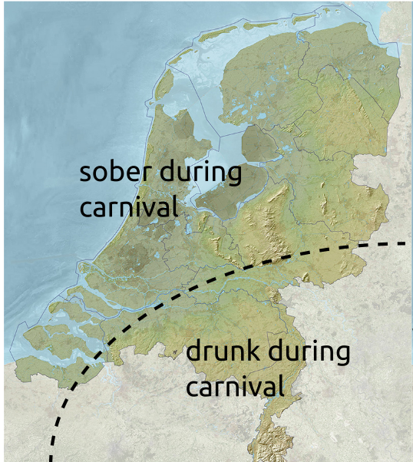
Notes:
Rio de Janeiro, New Orleans, Cologne and the south of the Netherlands are all famous for their carnival – an annual celebration of exuberance and excess prior to the penance and self-denial of Lent. What binds those far-flung parts of the world together is their catholic heritage. The Netherlands south of the Big Rivers – Meuse and Rhine, which can be seen slicing the country in two latitudinally on the maps – is generally catholic, the north is mostly protestant. Although neither confession is as strictly observed as a few generations ago, the difference in attitudes is still observable in some vestigial cultural differences – such as the celebration of carnival.

Slide 8
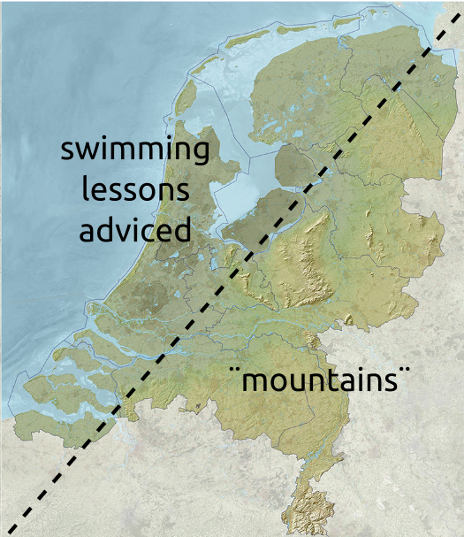
Notes:
As the country’s name indicates, the Netherlands are a low-lying country. About a quarter of its area, and a fifth of its population is located below sea level. That would be to the west of this line. But even the ‘dry’ land to the east is fairly low-lying. Only about 50% of the national territory exceeds an elevation of one metre (about three feet) above sea level. It is telling that the highest point in the Netherlands is at its very southern tip, in Vaals (2). And that the so-called Vaalserberg, 322.7 m (1,059 ft) above sea level, isn’t even entirely within the Netherlands: its top forms an international tripoint with Belgium and Germany – and at one time, a quadripoint with the geopolitical anomaly of Neutral Moresnet (3). Still, it’s better to be a low country than a below country, in case the dykes break.
Close to my home: Wageningse Berg (42m / 137 ft) and Grebbeberg (52m / 170ft) above sea level ☺

Slide 9
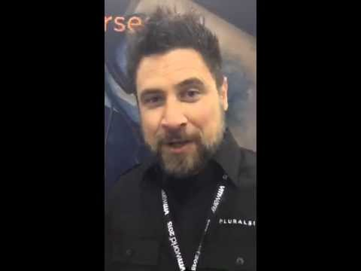
Why’s a lab environment so important?

Slide 10
Aimed config
Domain Controller
Domain: TechMentor2017.com
DNS
DHCP, including scope

Slide 11
Steroids? Automate it!
Various options:
MDT
NewLabEnvironment
Lability

Slide 12

Let’s pray to the DEMO Gods

Slide 13
DEMO
MDT

Slide 14
NewLabEnvironment
The story behind NewLabEnvironmet

Slide 15
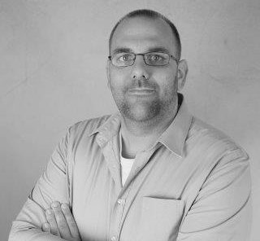
2 guys, 1 module

Slide 16
Treat your lab as LEGO
Hardware: the base plate
Windows Server & Powershell: the bricks
Whatever you decide to do with it: the building

Slide 17
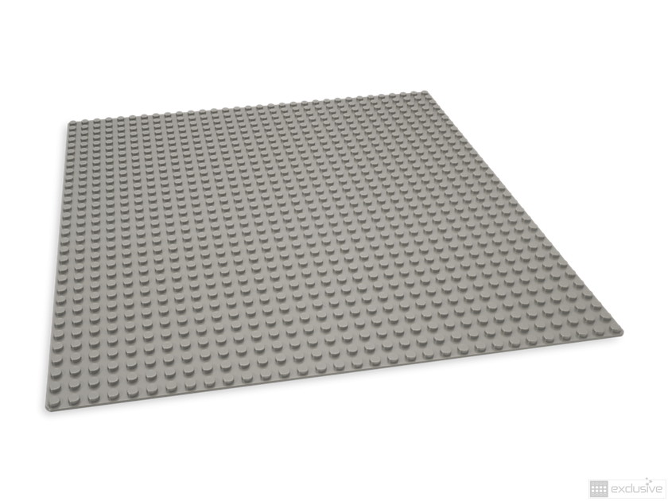
The hardware

Slide 18
Hardware; demands and wishes
Small & mobile
Plenty of RAM
Enough IOPS
Tight budget ;)

Slide 19
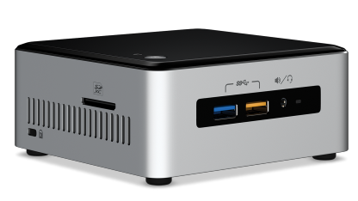
Hardware (example)
Intel NUC Core i5
M.2 PCiE-slot and SATA-600
Max 32GB DDR4 SoDIMM RAM
NUC + 2x16GB + 240GB SSD: about $800,00 incl VAT

Slide 20
The basics; demands and wishes
Hypervisor as base OS
Management using known tools
Separate networking
Ease of rolling out new VM’s
Nested virtualization

Slide 21
The basics
Windows Server 2016 as base OS
Known management
Use of GUI possible (if you would feel the need)
NAT vSwitch
Powershell for scripting

Slide 22
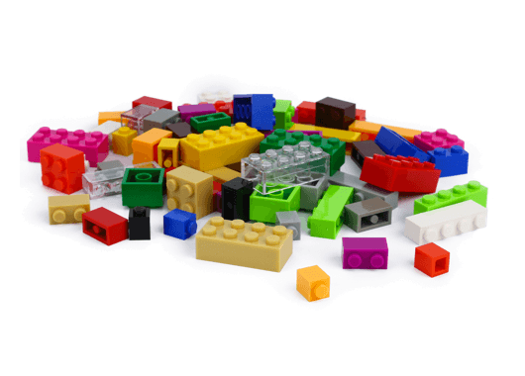
The bricks

Slide 23
Saving on storage
Differencing disks
Create a VM and use this as the base disk for all your new VM’s

Slide 24
Networking
The best of an external and internal vSwitch combined
Isolated and independent from the host
Internet access through the host
Portmapping possible

Slide 25
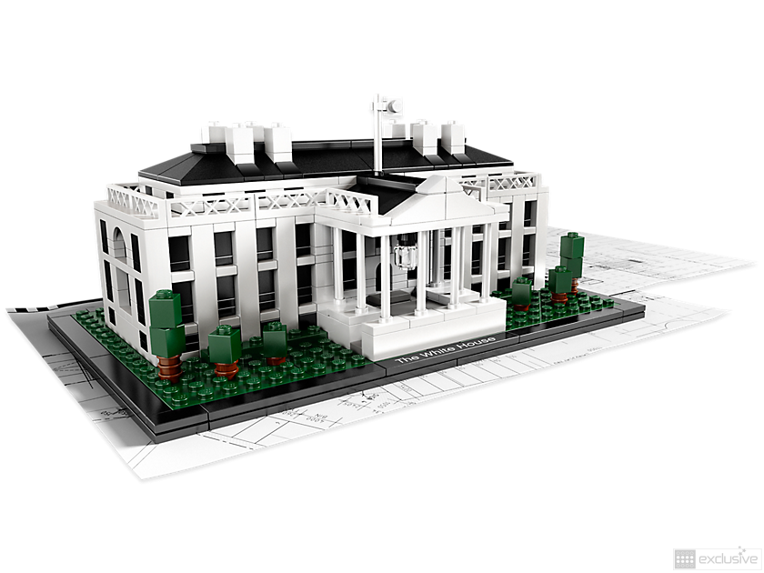
Let’s build!

Slide 26
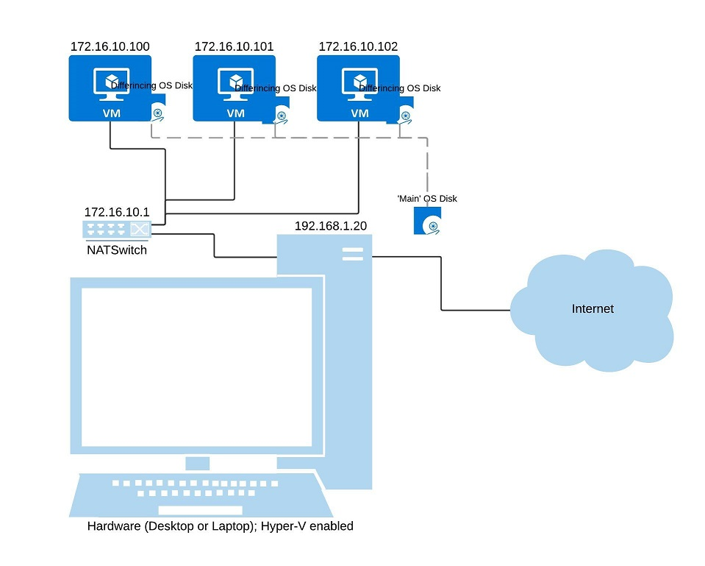
The big picture

Slide 27
Networking
Create a new ‘internal’ vSwitch
Assign a static internal IP
Set up NAT for this switch

Slide 28
Steps to roll out a new VM
New disk based on differencing disk
New VM on this disk
Import and edit the unattend.xml and copy this to the new VM
Start the new VM

Slide 29
Adding purpose to the VM’s
VM’s are ‘empty’ up till now
Still a lot of manual tasks to perform to build an AD environment for instance
Why not automate that?

Slide 30
How to automate
Use Azure Automation DSC
Free up to 5 nodes
Initialy, no on-premises infra needed (unless you want use more than 5 nodes)

Slide 31
New bricks added
An Azure subscription
Free trail/pay-as-you-go/MSDN/SA-contract/etc.
The AzureRM PowerShell module

Slide 32
New bricks added (2)
An automation account within the subscription
A DSC config to upload and compile
A DSC metaconfig to ‘onboard’ the machine to AzureDSC

Slide 33
DEMO
NewLabEnvironment

Slide 34
DEMO
Lability

Slide 35
Thank you!
Don’t forget the evals!
All demo files will be made available on GitHub: www.github.com/svenvanrijen/techmentor2017

